Slide 1

an open-source framework for simulation and parameter estimation in geophysics
Lindsey Heagy¹, Santiago Soler¹, Joseph Capriotti², Devin C. Cowan¹, Dominique Fournier³, Seogi Kang⁴, Rowan Cockett⁵, and Douglas W. Oldenburg¹
¹University of British Columbia – Geophysical Inversion Facility
²Colorado School of Mines
³Mira Geoscience
⁴University of Manitoba
⁵Curvenote Inc
ICCOPT – 2025

Slide 2
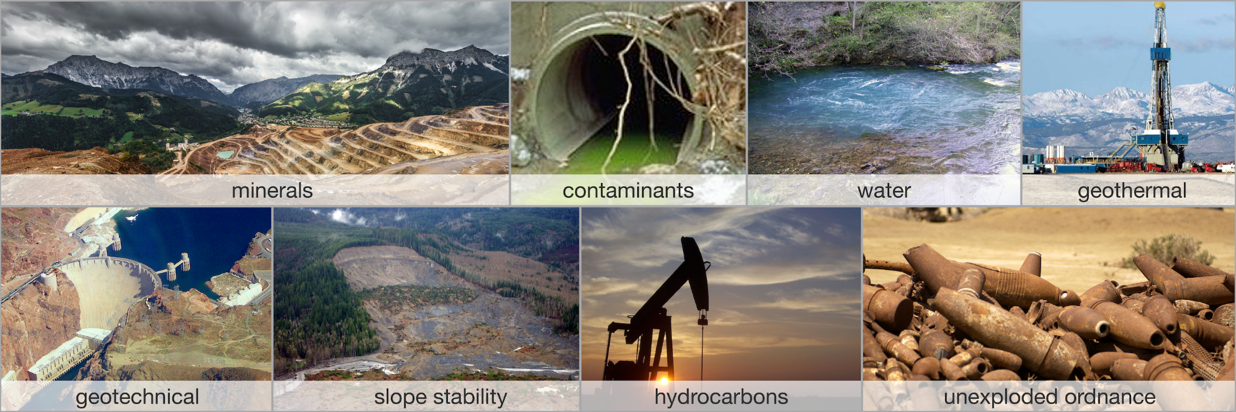
applications
in all… need to “image” the subsurface non-invasively

Slide 3
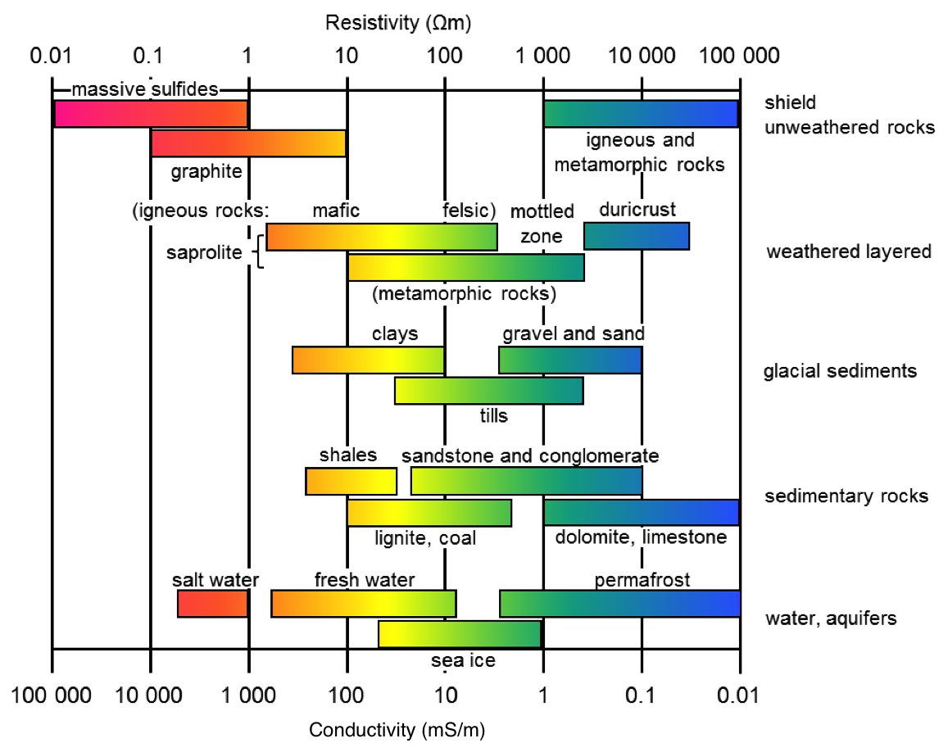
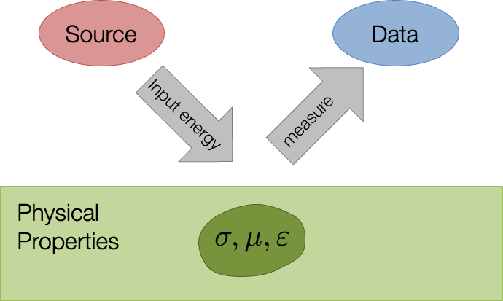
generic geophysical experiment

Slide 4
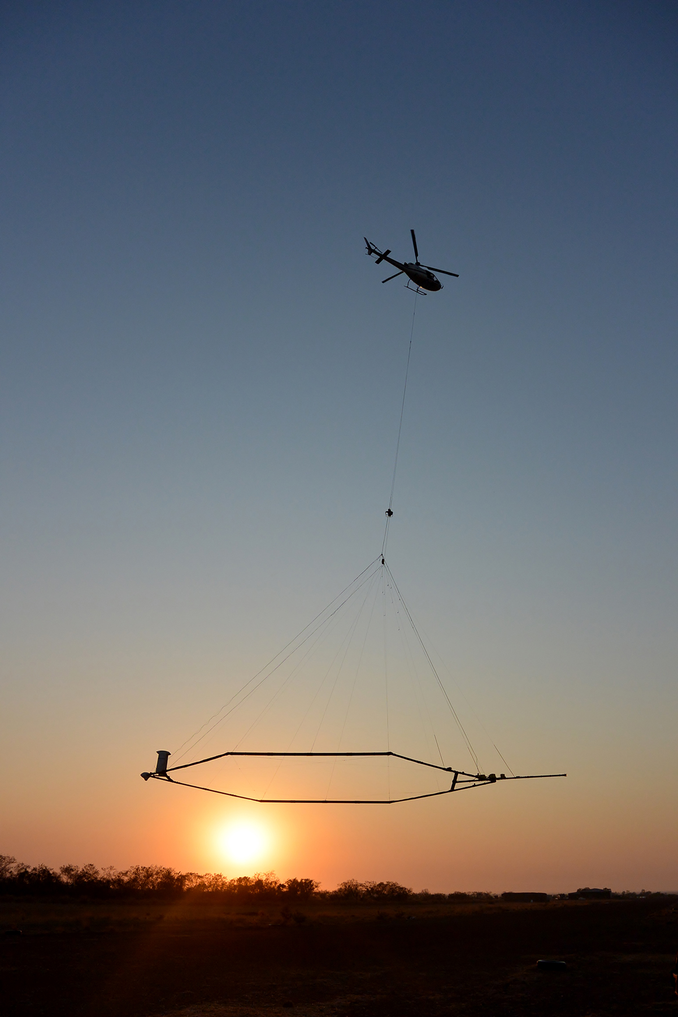
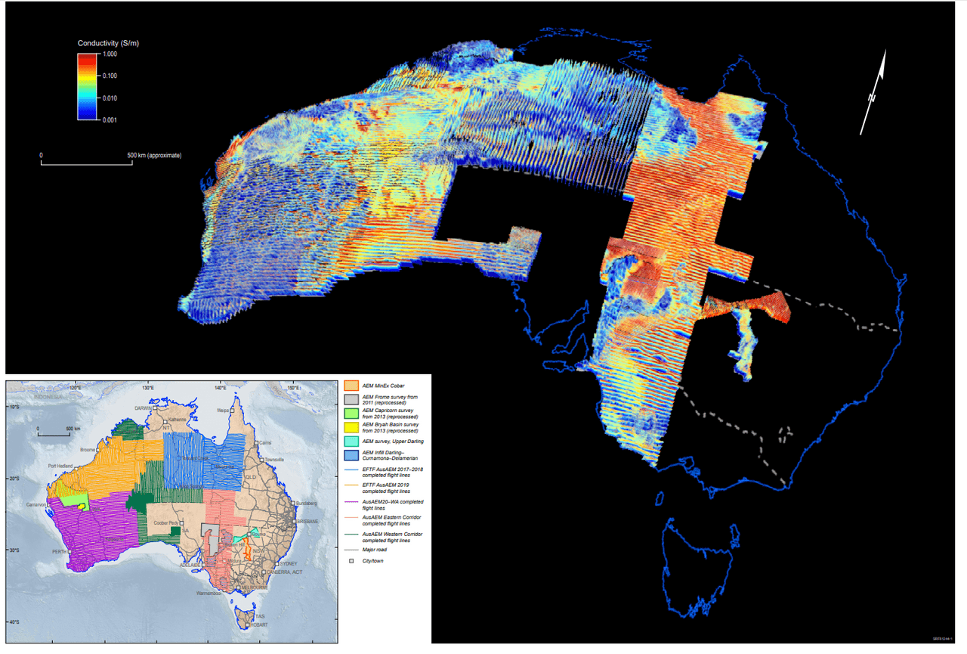
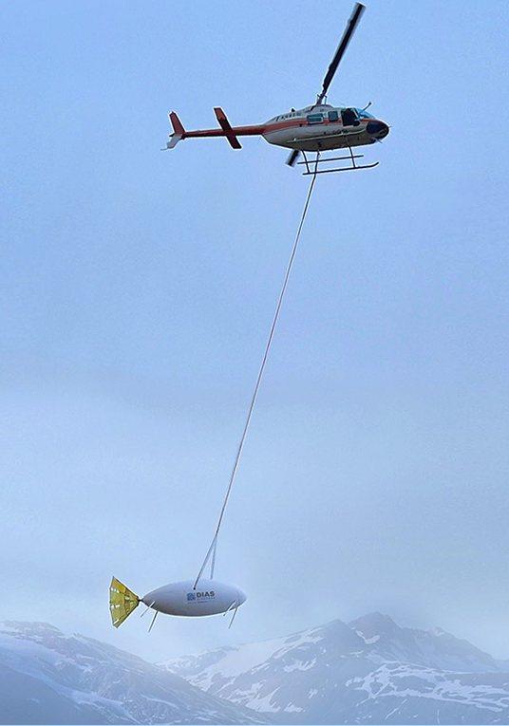
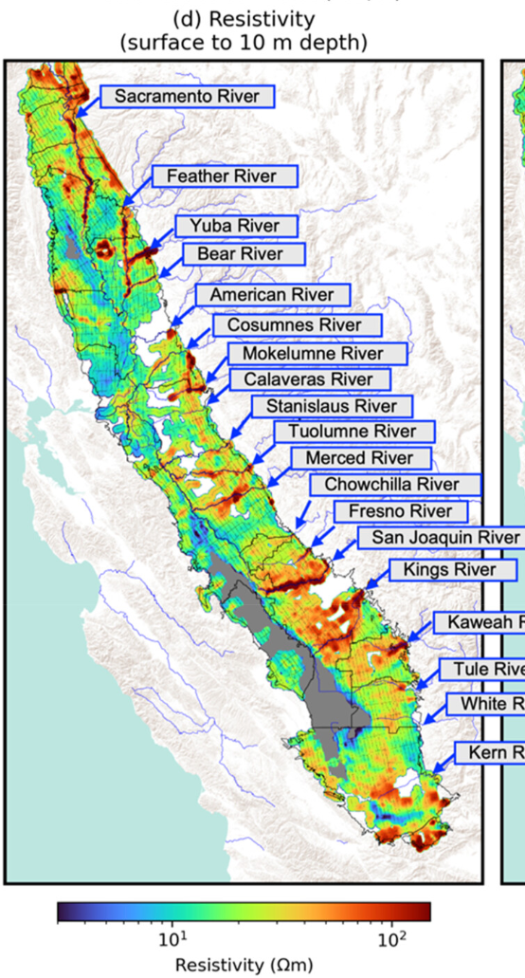
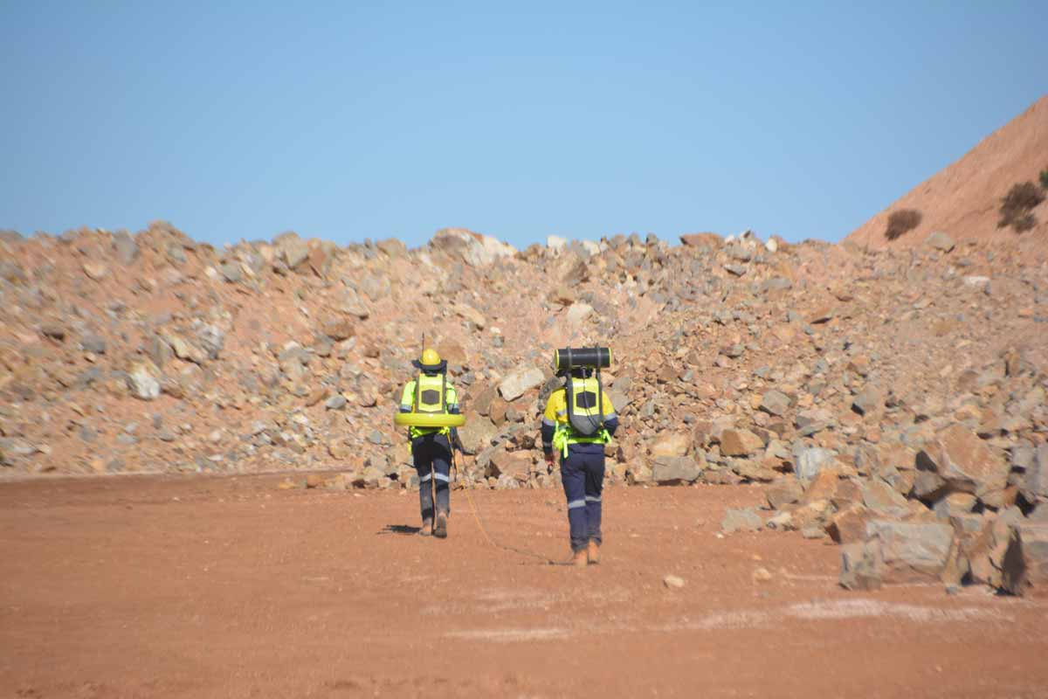
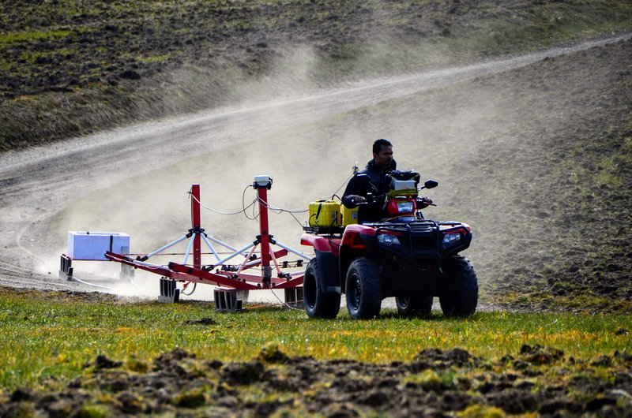
geophysical experiments
often on large scales
airborne
AUSAEM
Central Valley, California (Kang et al., 2025)
ground or borehole

Slide 5
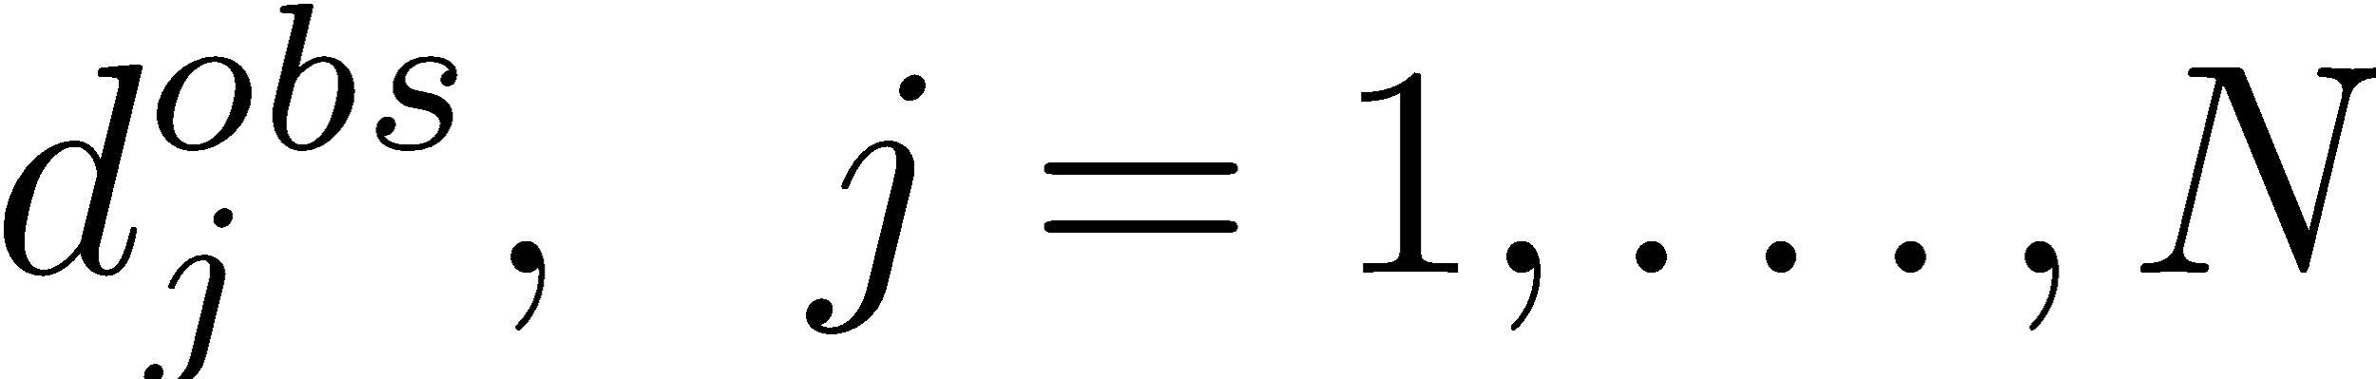
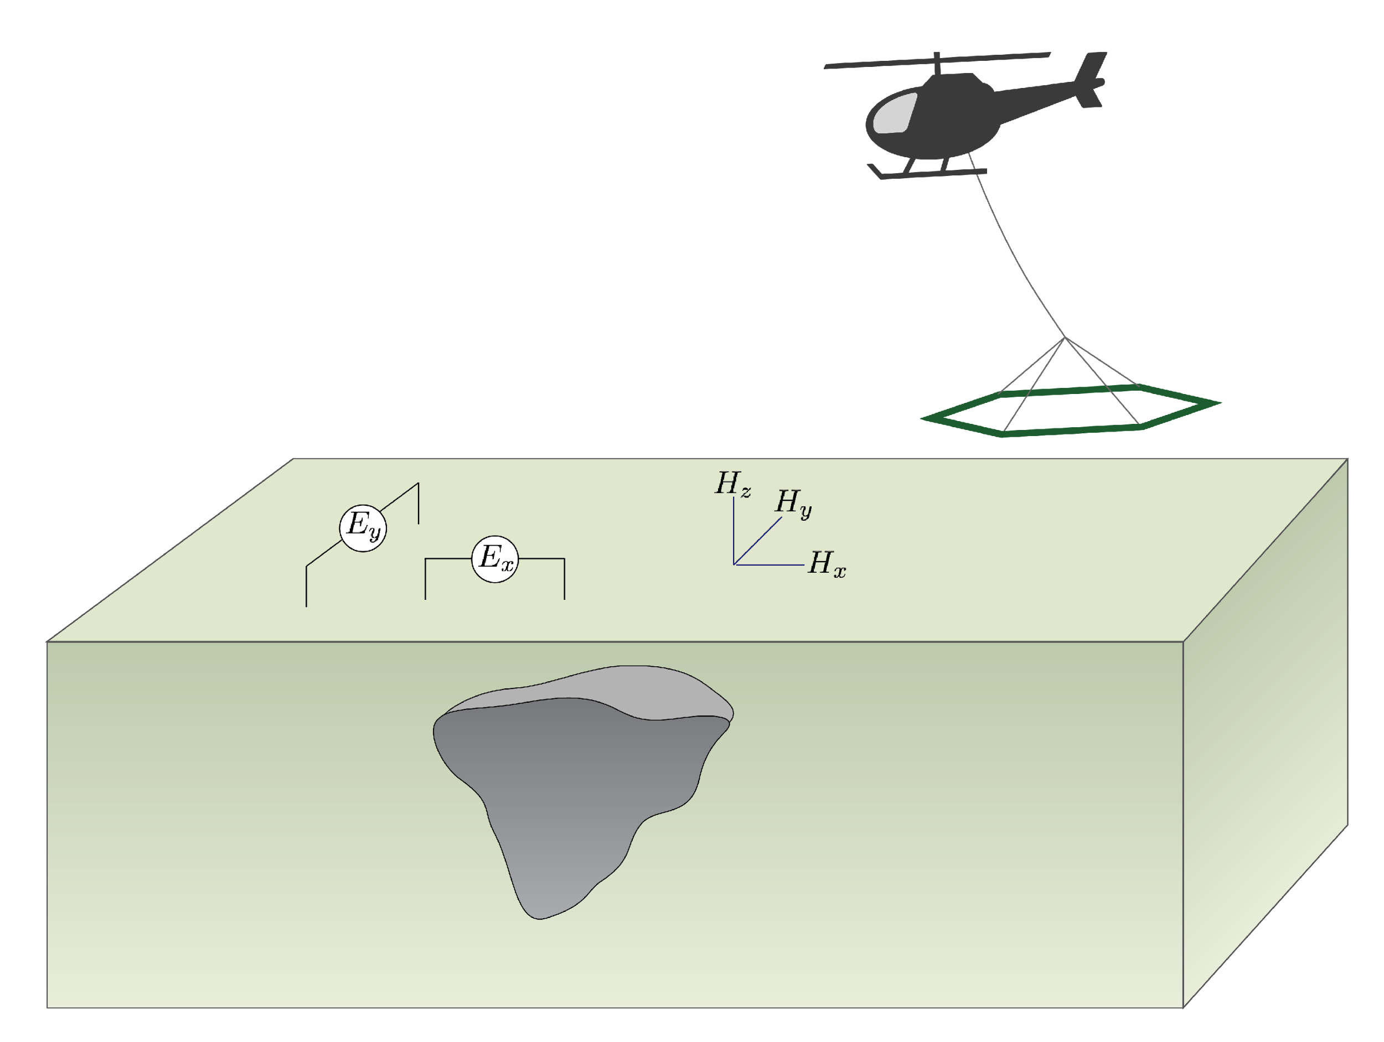
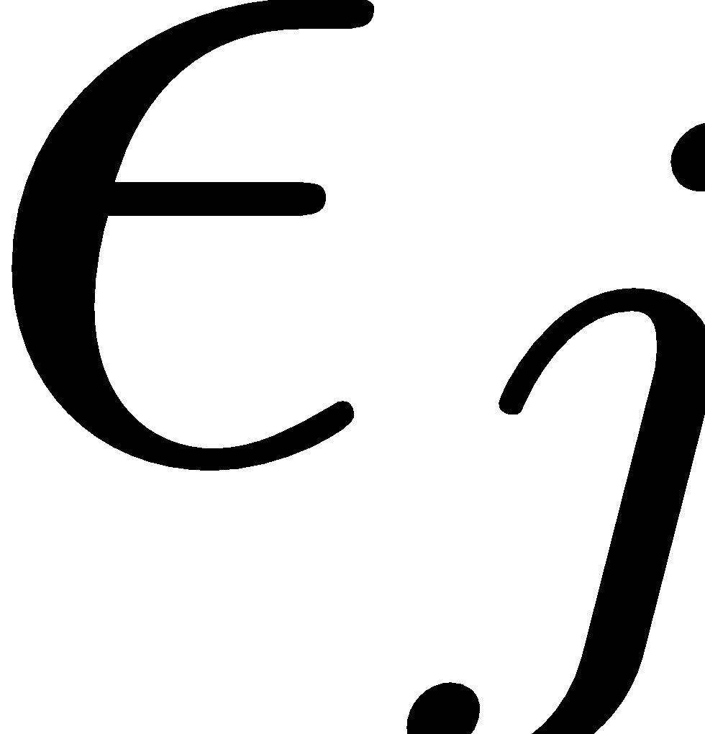
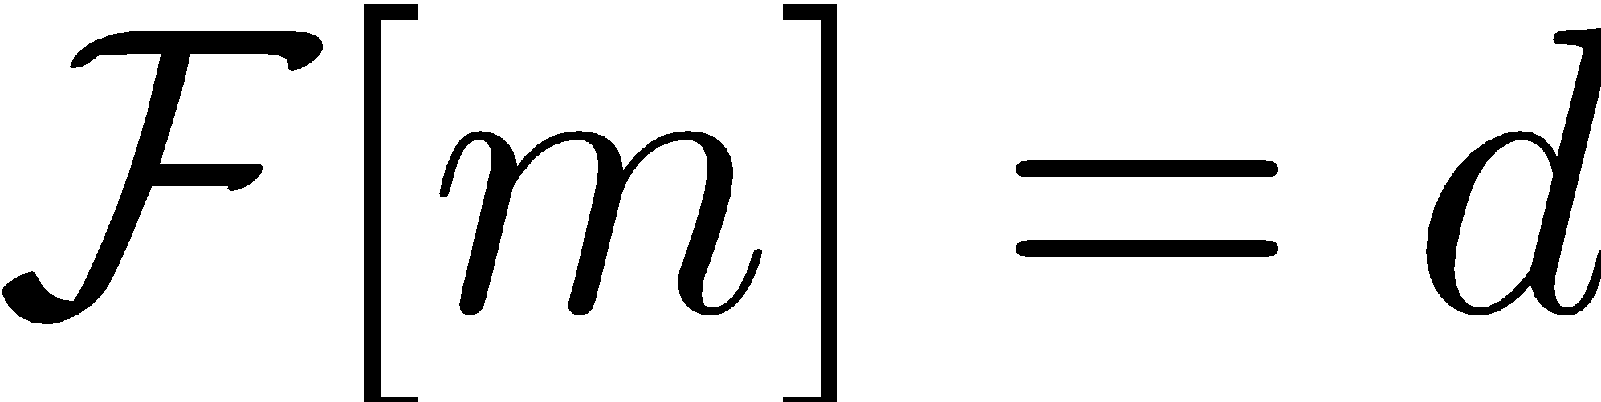
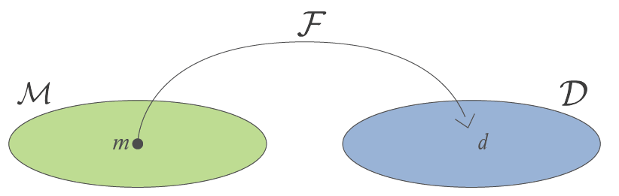
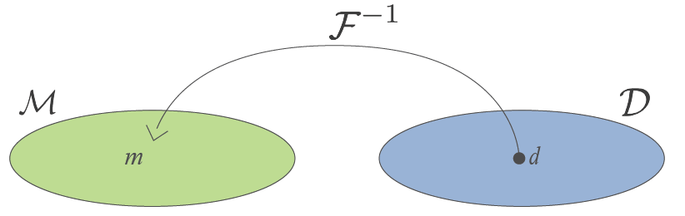
statement of the inverse problem
Given
observations:
uncertainties:
ability to forward model:
Find an Earth model that fits those data and a-priori information

Slide 6
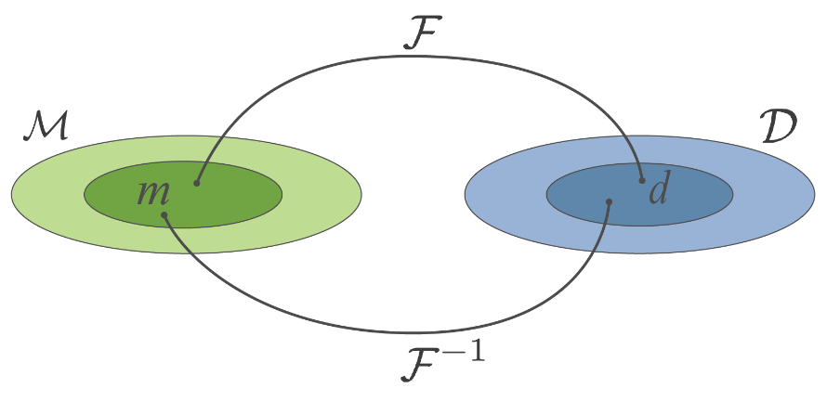
inverse problem
The inverse problem is ill-posed
non-unique
ill-conditioned
Any inversion approach must address these issues.

Slide 7
inverse problem
Prior information important to constrain the inversion
geologic structures
boreholes
reference model
bounds
physical properties
other geophysical data
…

Slide 8

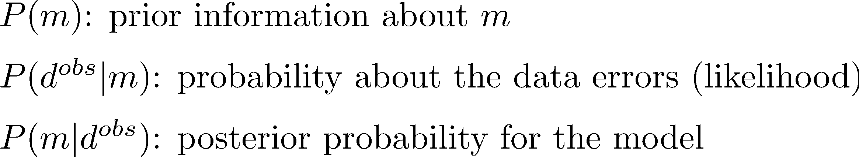
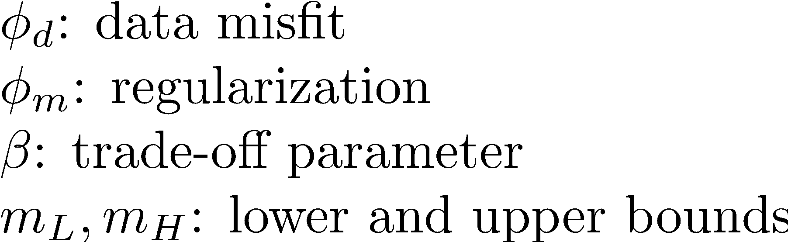
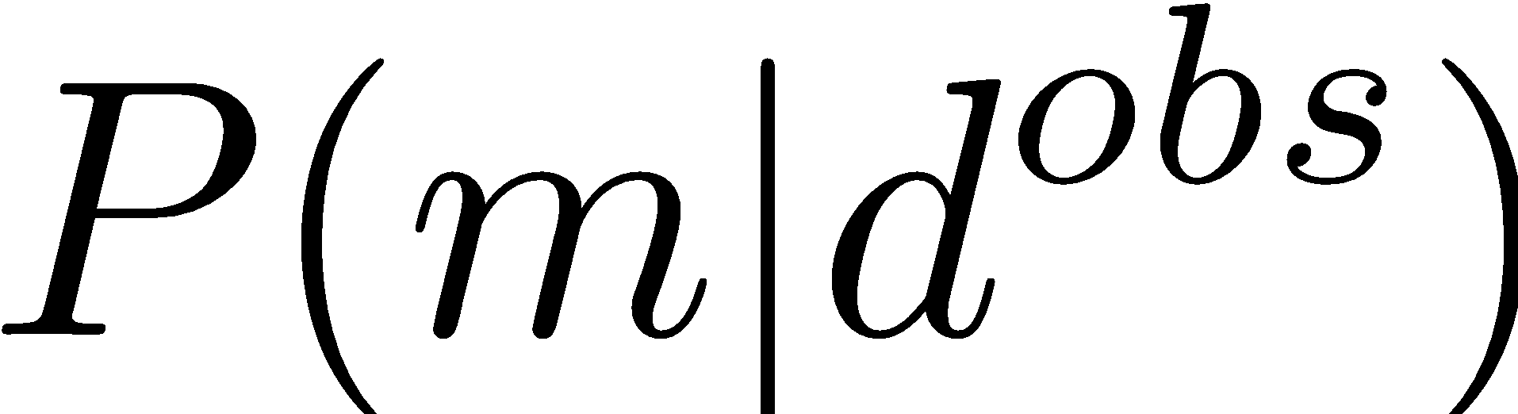
need a framework for inverse problem
Tikhonov (deterministic)
Bayesian (probabilistic)
Find a single “best” solution by solving optimization
Use Bayes’ theorem
Two approaches:
Characterize
Find a particular solution that
maximizes
MAP: (maximum a posteriori) estimate
Notes:
Likelihood of data

Slide 9
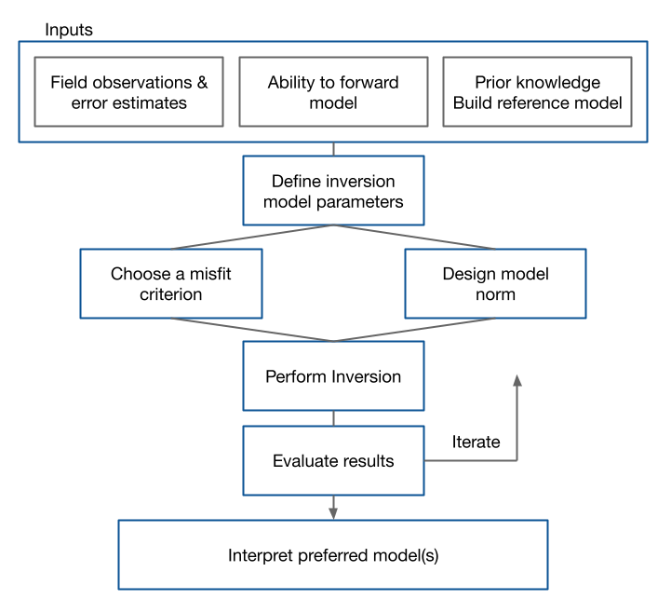
flow chart for the inverse problem
iterative process to obtain solution
each component requires evaluation, adjustment by user
opportunities for research within each component

Slide 10
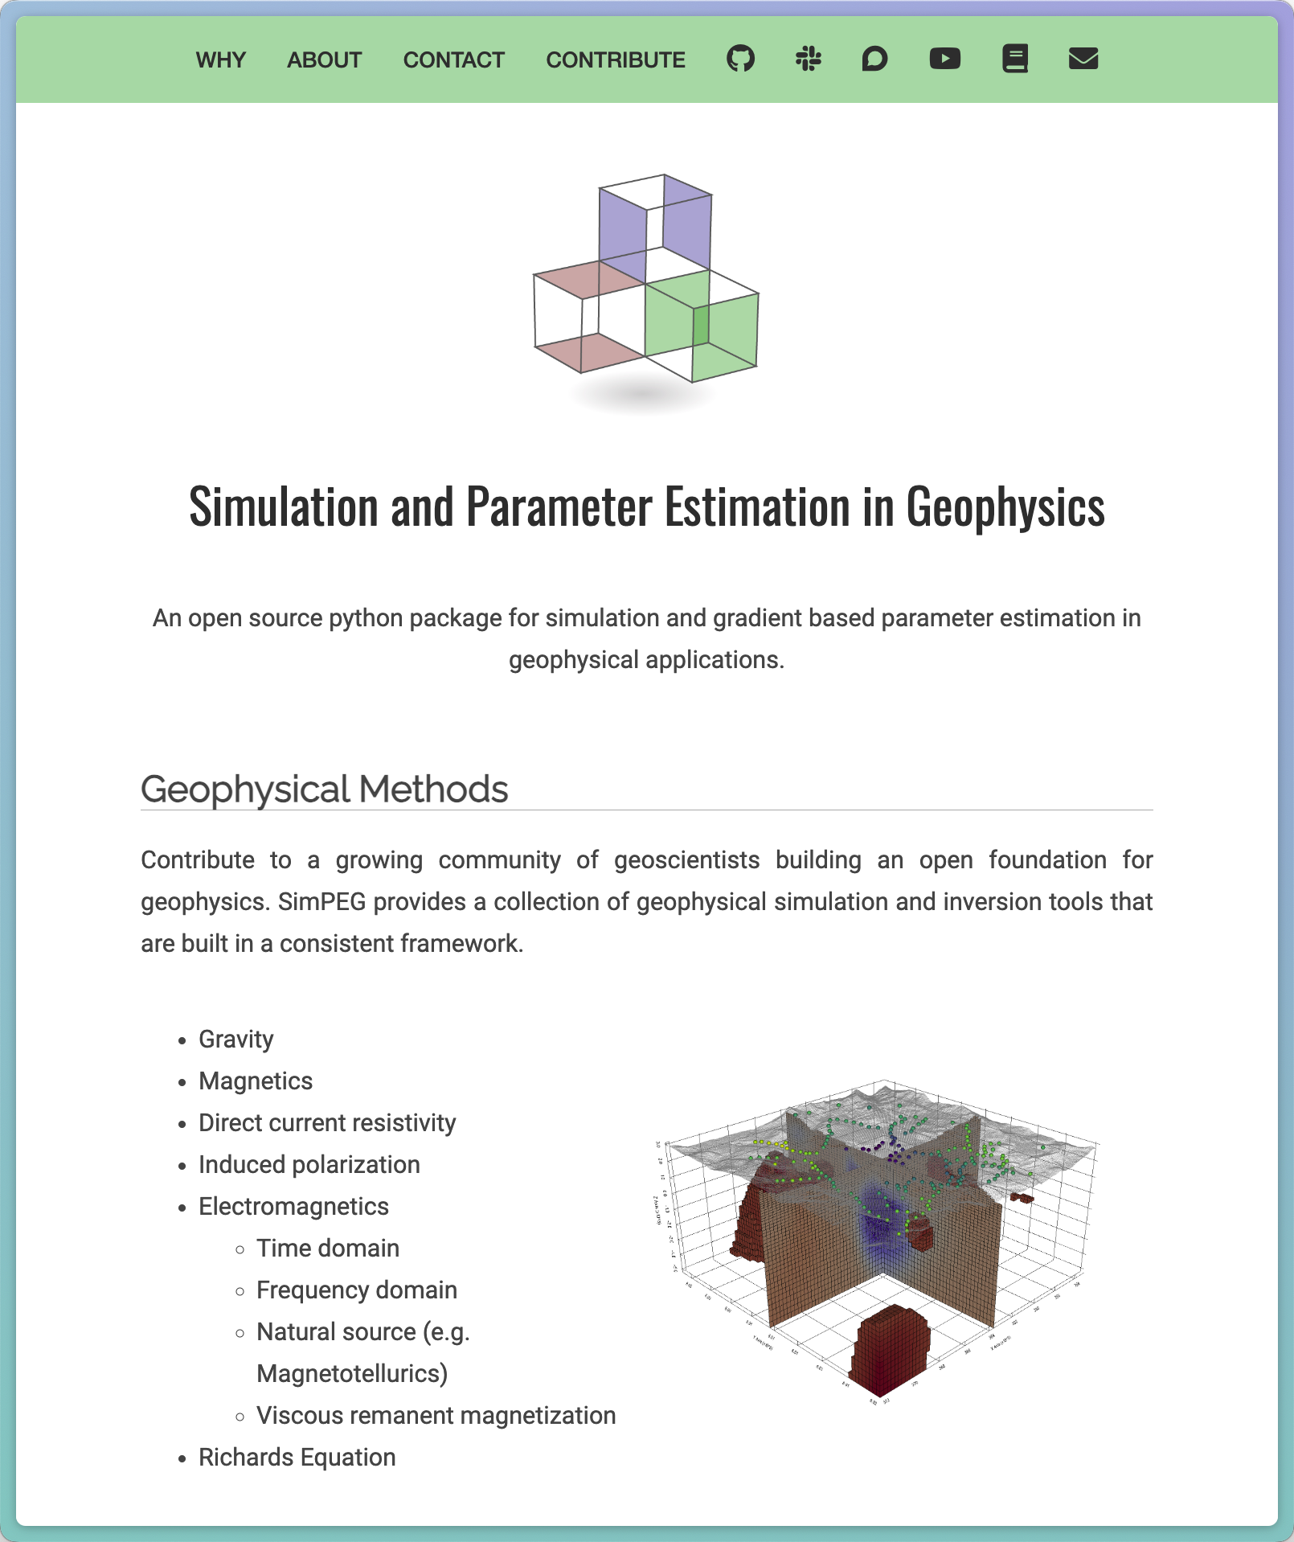
Simulation and parameter estimation in geophysics
common framework for simulations & inversions
accelerate research: build upon others work
facilitate reproducibility of results
build & deploy in python
open-source
https://simpeg.xyz

Slide 11
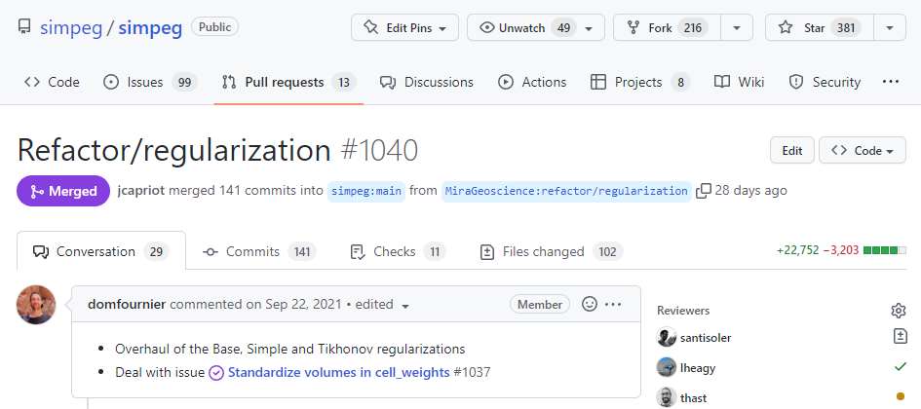
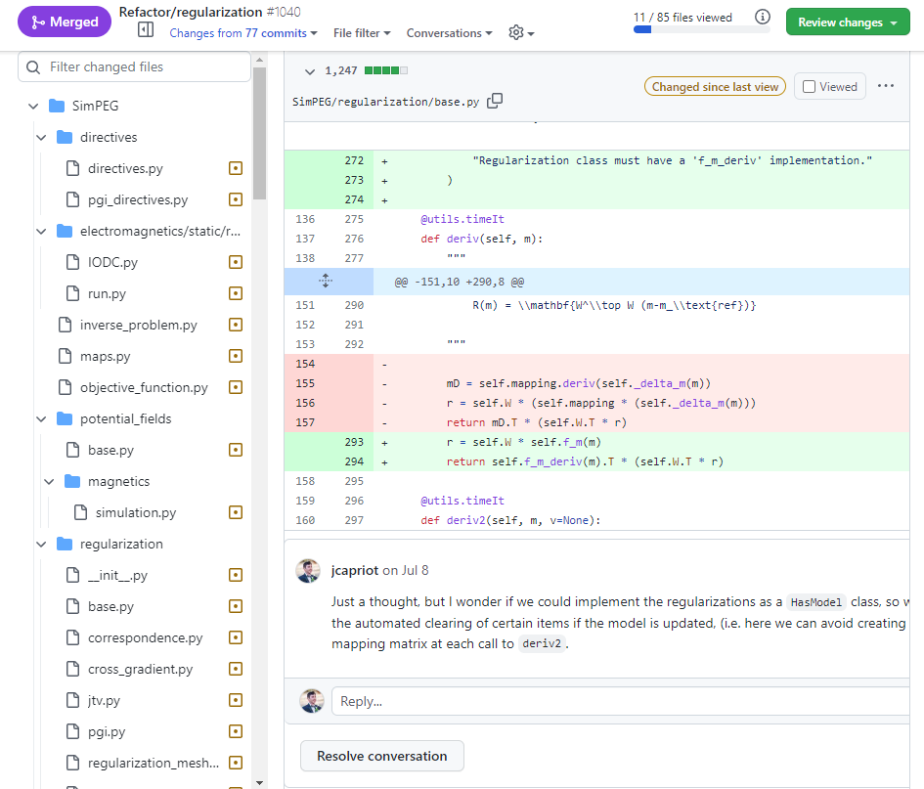
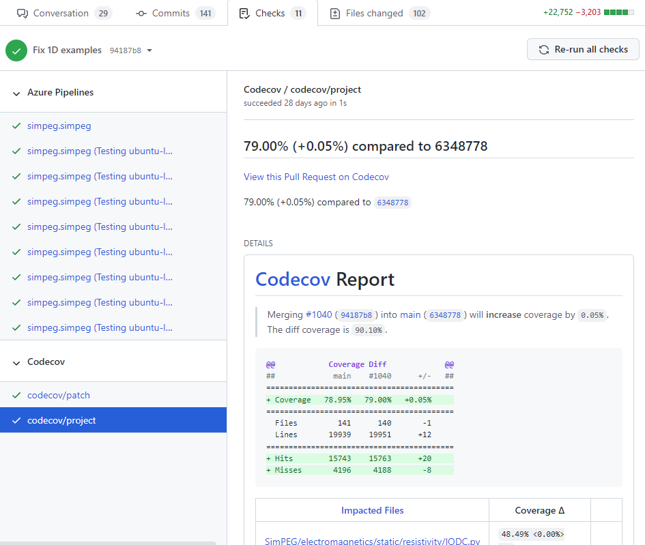
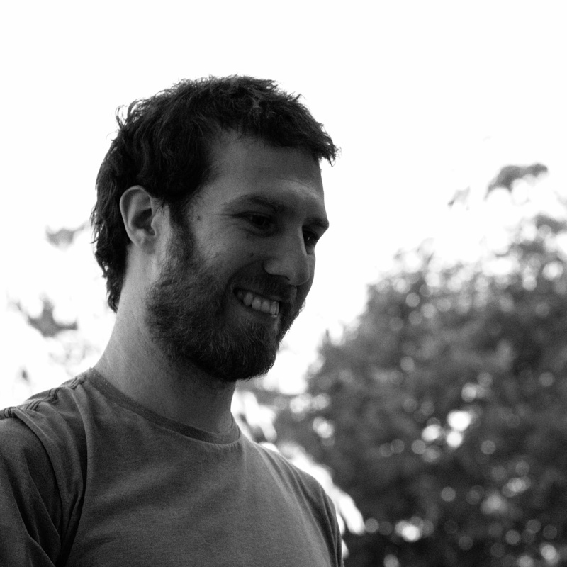


open development: how contributions get included
Submit proposed changes
(Pull Request)
SimPEG community + maintainers review changes
Ensure existing unit tests pass
and changes are also tested
maintainers
https://github.com/simpeg/simpeg
S. Soler
J. Capriotti
Notes:
Driven by research ideas and industry needs
Iterative feedback between simpeg maintainers and feature submission contributers
Tested for reliability

Slide 12
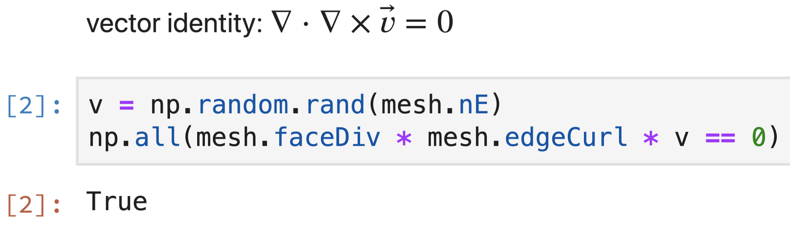
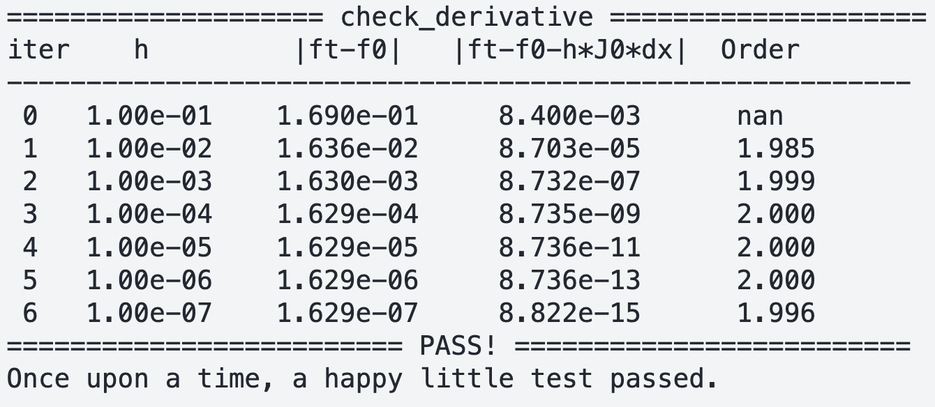
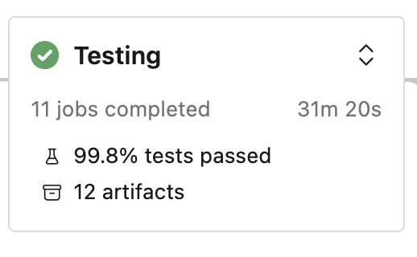
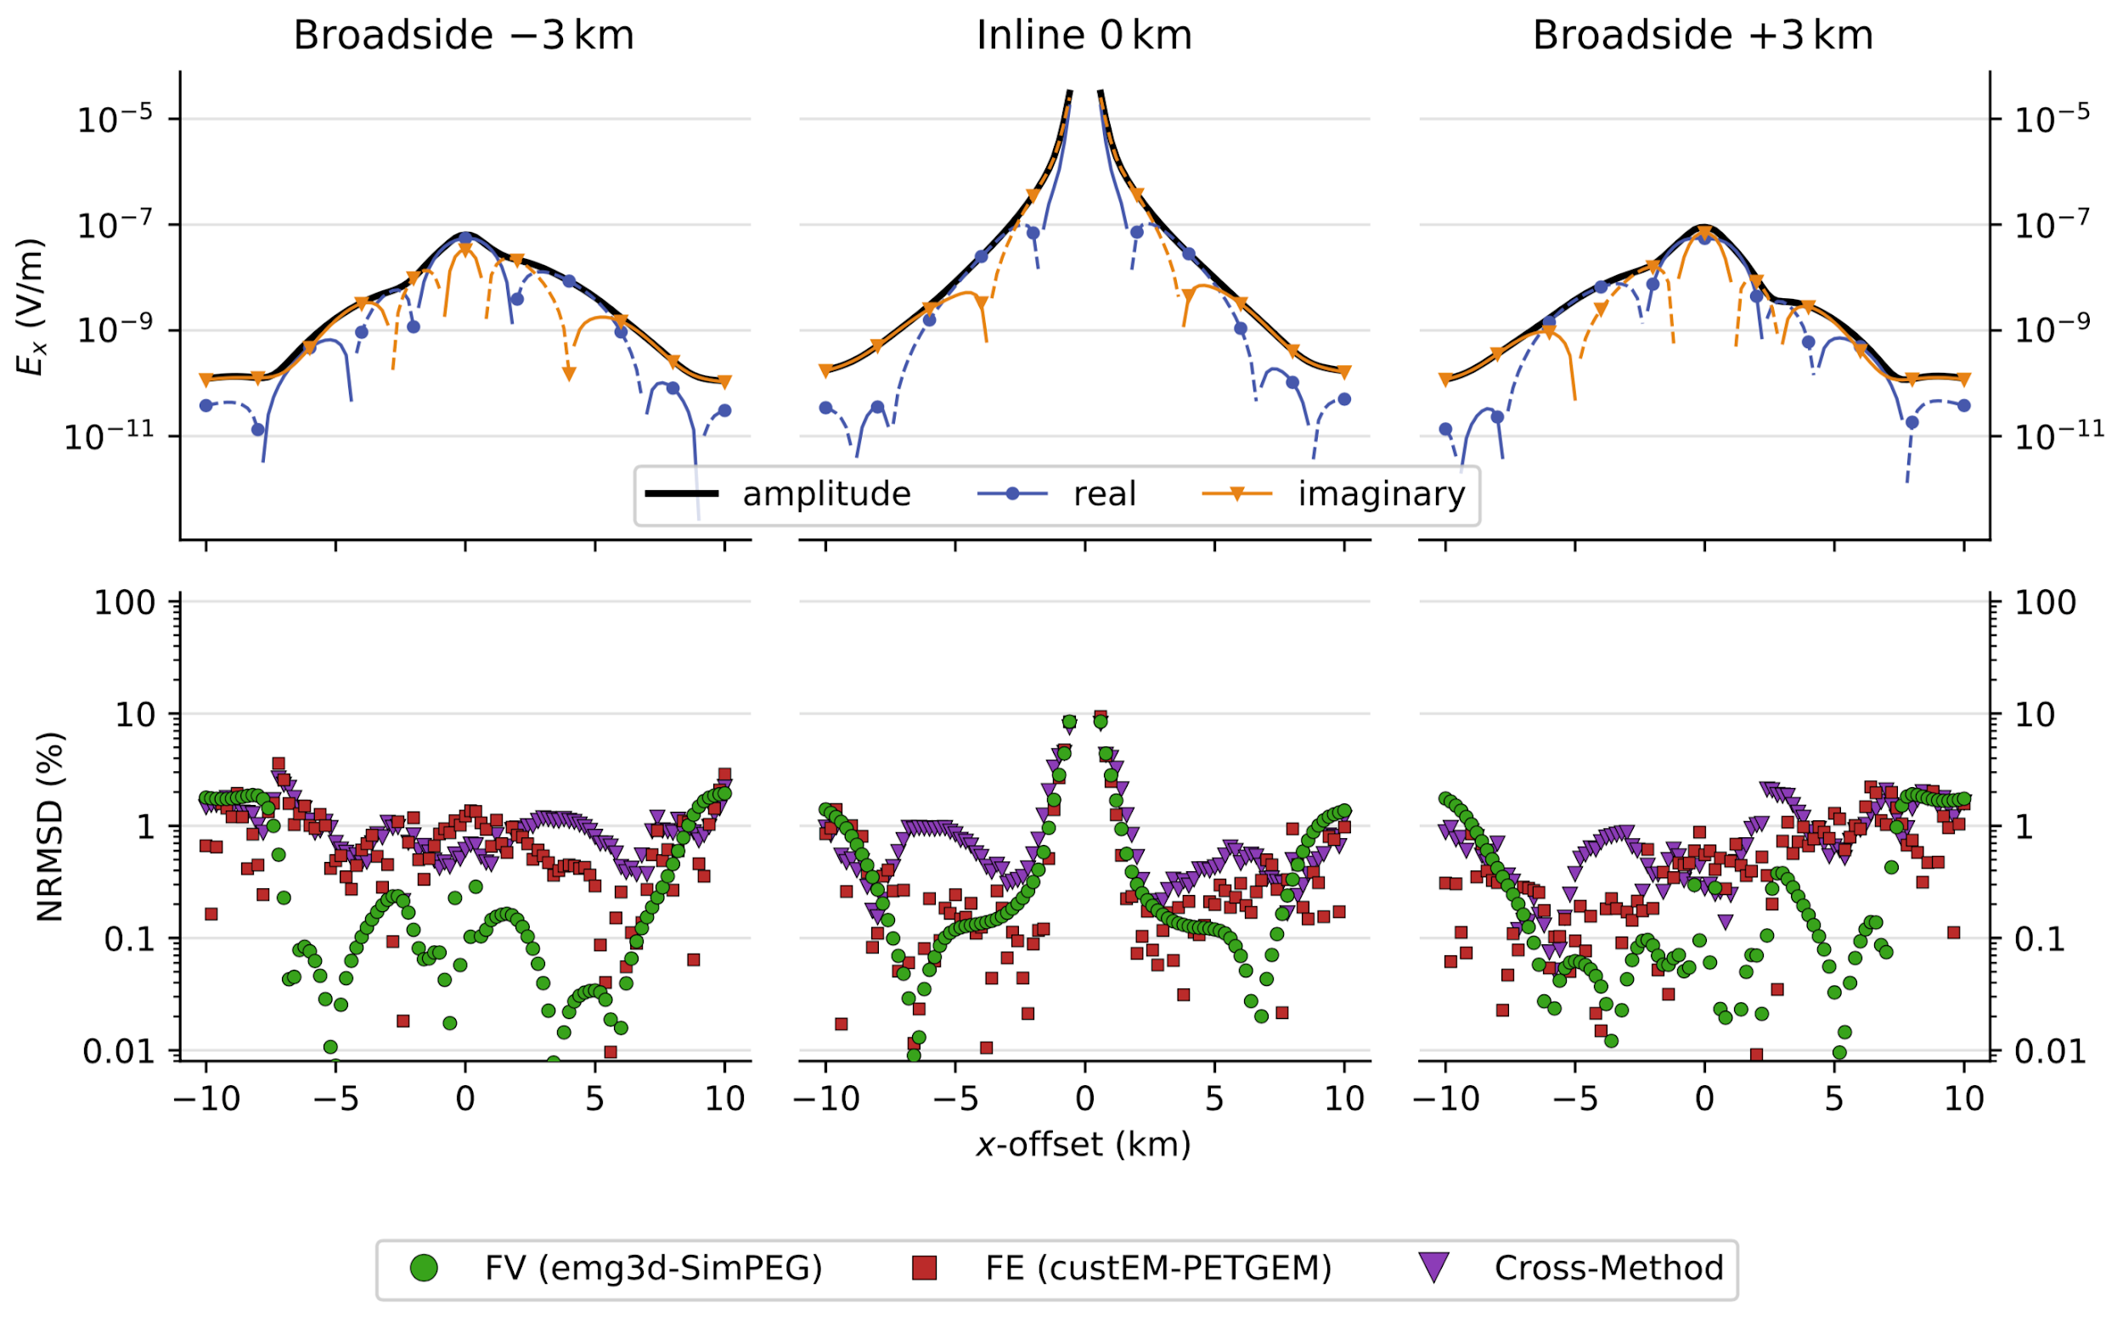
testing
mathematical properties
analytic solutions, convergence criteria
confidence
code comparisons
(Werthmüller et al., 2020)

Slide 13
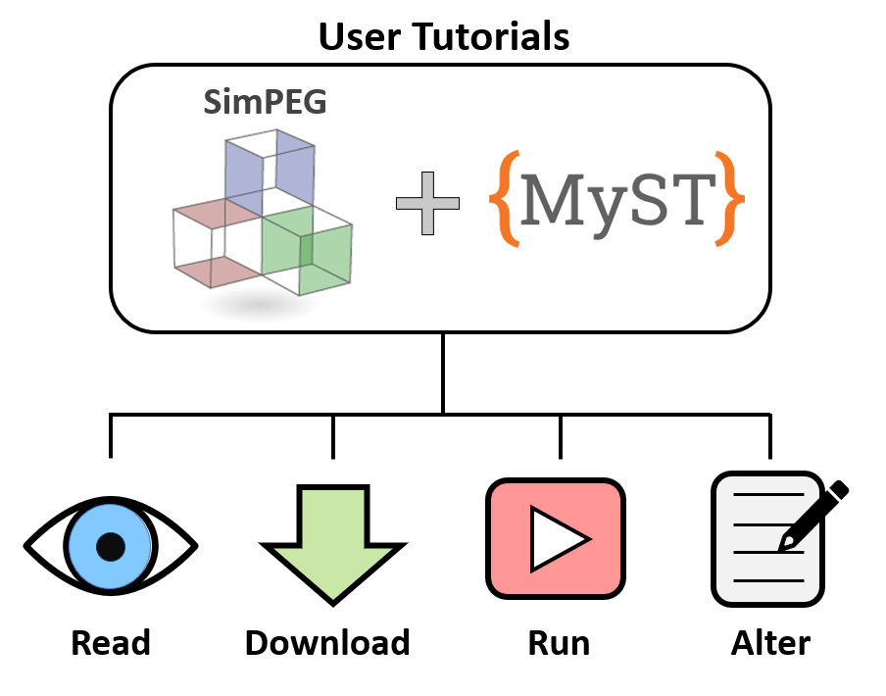
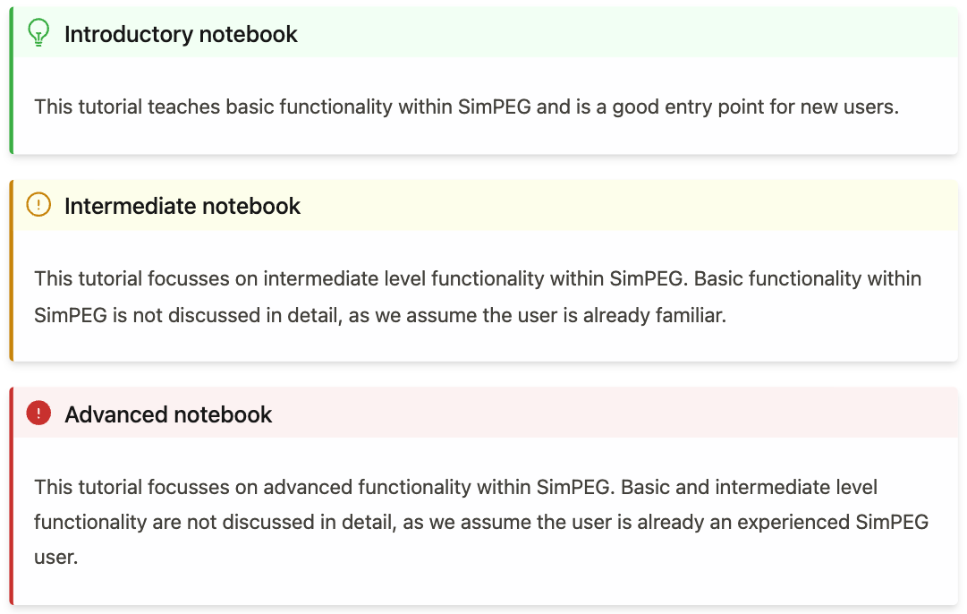
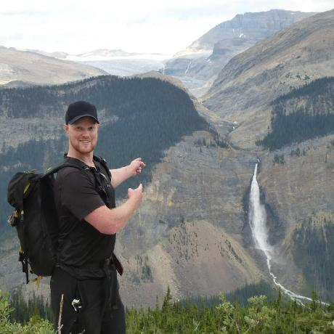
user tutorials
growing library of training materials:
parameter choices in setting up forward simulations, inversions, e.g.mesh design, regularization parameters
basic, intermediate, and advanced forward simulation and inversion approaches
understanding SimPEG objects
https://simpeg.xyz/user-tutorials
D. Cowan
S. Soler

Slide 14
flow chart for the inverse problem

Slide 15
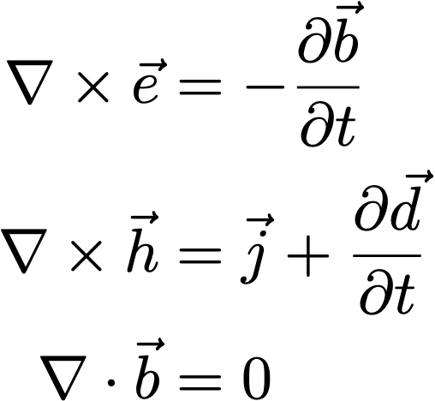
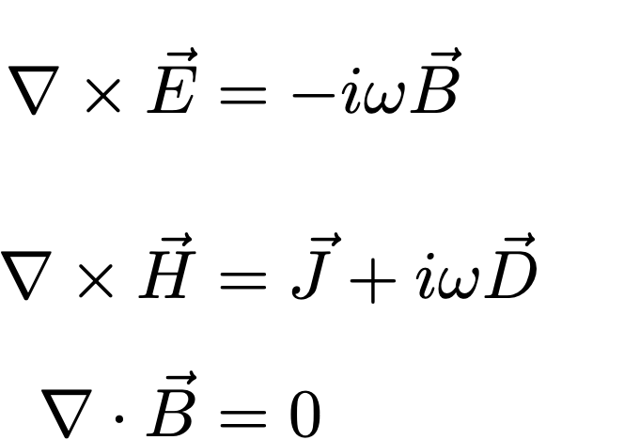
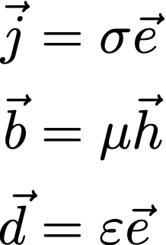
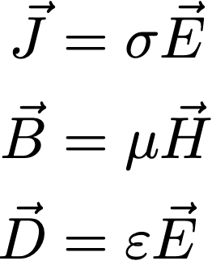
electromagnetics: basic equations (quasi-static)
Time
Frequency
Faraday’s Law
Ampere’s Law
No Magnetic Monopoles
Constitutive
Relationships
(non-dispersive)
* Solve with sources and boundary conditions

Slide 16
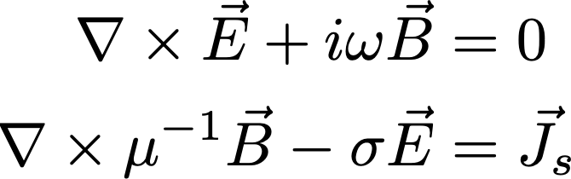
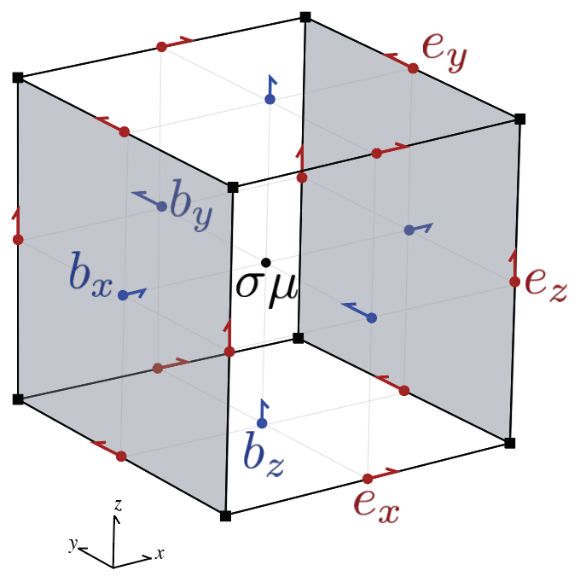
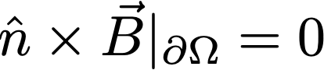
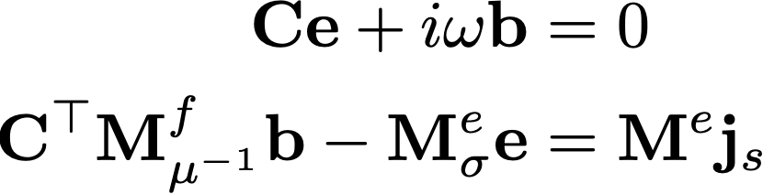
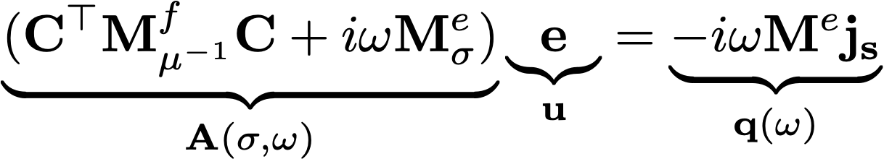
electromagnetics: frequency domain
Continuous equations
Finite volume discretization
Eliminate b to obtain a second-order system in e
(Haber, 2014; Cockett et al, 2016)

Slide 17

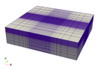
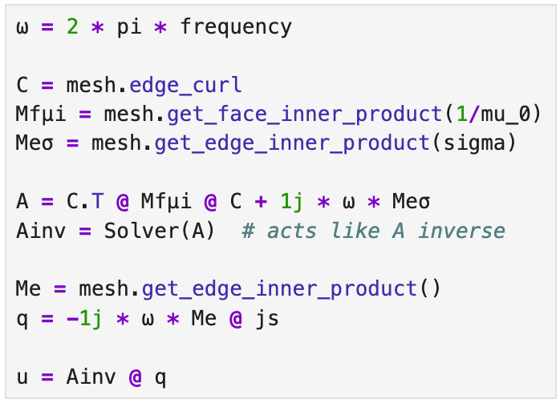
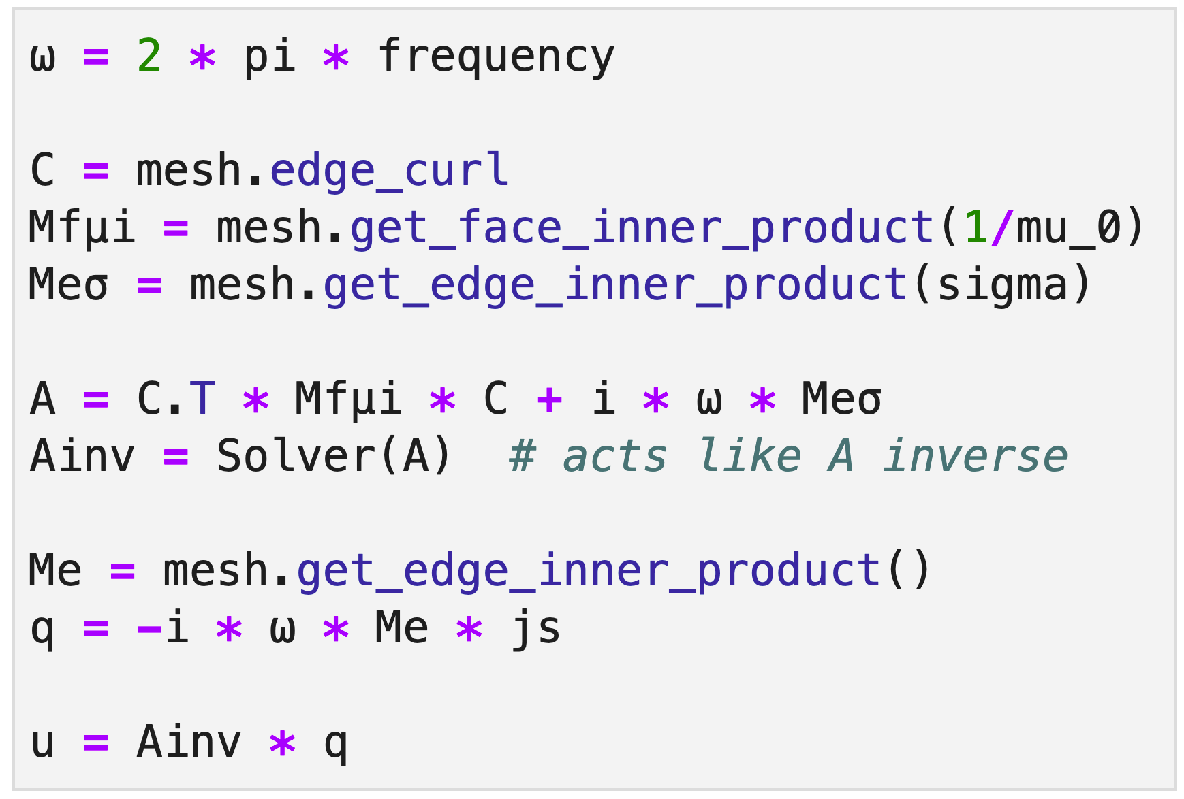
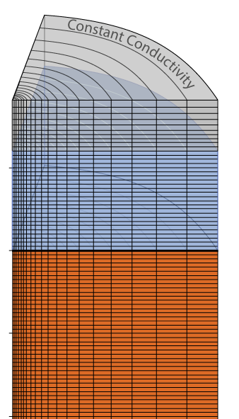
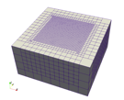

solving a FDEM problem
Tensor
Cylindrical
OcTree
Notes:
ω = 2 * pi * frequency
C = mesh.edge_curl
Mfμi = mesh.get_face_inner_product(1/mu_0)
Meσ = mesh.get_edge_inner_product(sigma)
A = C.T @ Mfμi @ C + 1j * ω * Meσ
Ainv = Solver(A) # acts like A inverse
Me = mesh.get_edge_inner_product()
q = -1j * ω * Me @ js
u = Ainv @ q

Slide 18

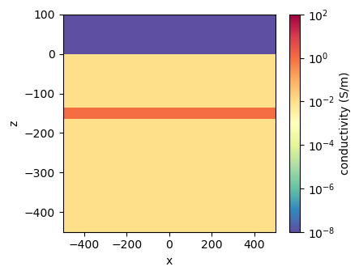
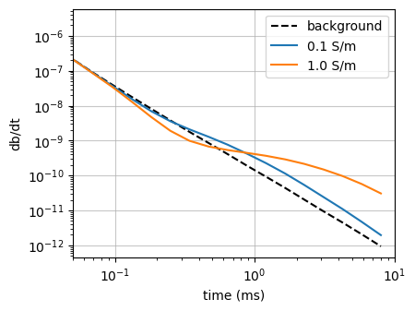
example: airborne electromagnetics
air: 10⁻⁸ S/m
layer
background: 10⁻² S/m

Slide 19
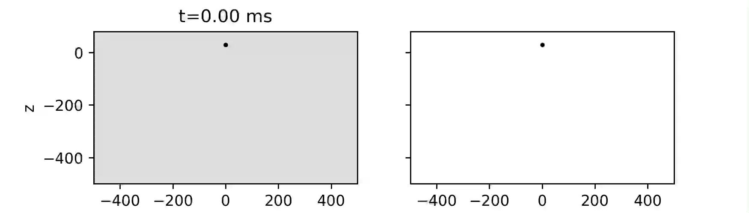
example: airborne electromagnetics
halfspace
current density
db/dt

Slide 20
example: airborne electromagnetics
halfspace with a conductive layer
current density
db/dt

Slide 21
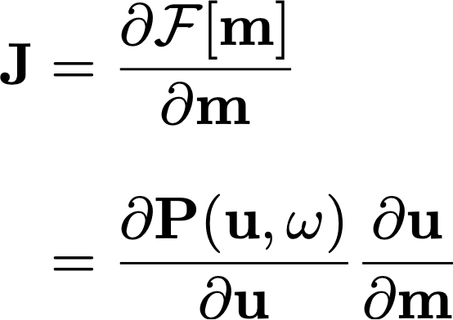

sensitivities
For inverse problem, need sensitivities (and adjoint)
where the derivative of the fields (u) is computed implicitly (requires a solve)
J is a large, dense matrix → compute products with a vector if memory-limited
Notes:
(and put some numbers? say you have 1 M cell and 100,000 datum, then the size of the matrix 0.1M x 1M = 100B)

Slide 22
flow chart for the inverse problem
What do we need for inversion?
From the simulation
adjoint sensitivity times a vector
sensitivity times a vector
Inversion components:
define a model norm
perform optimization

Slide 23




inversion as an optimization problem
data misfit
typical model norm
smallness
first-order smoothness
uncertainties captured in W
discretize

Slide 24

solving the optimization problem
standard approach: Gauss Newton–CG + ꞵ-cooling strategy

Slide 25
different flavours of inversion & research opportunities
Two examples:
Sparse & compact norms
Using a GMM in the model norm

Slide 26
example 1: sparse / compact norms

Slide 27



sparse / compact norms with IRLS
Fournier et al, 2019
Magnetic vector inversion (MVI)
inversion results: cross-section

Slide 28
sparse / compact norms with IRLS
Fournier et al, 2019
Magnetic vector inversion (MVI)
inversion results: cross-section

Slide 29



sparse / compact norms with IRLS
developed in potential fields
adapted to time-lapse electromagnetics: groundwater
difference.
no time constraint
difference.
L2 time constraint
2017
(Kang & Knight, 2022)
(Fournier et al, 2019)
difference.
L0 time constraint
2017
2019
Notes:
Dom did initial work in potential fields linear problem; seogi picked it up and applied it to a non-linear eM problem and extended it to sparse norm in time. No reimplementation

Slide 30
example 2: using a gaussian mixture model in the inversion

Slide 31


Using a Gaussian Mixture Model in the model norm
Example: Carbon mineralization – Rocks that have been serpentinized (altered) can react with CO₂ to from carbonated minerals. Reactions change physical properties
serpentinization
carbonation
Cutts et al., 2021; Mitchinson et al., 2020

Slide 32



Using a Gaussian Mixture Model in the model norm
Petrophysically and Geologically guided Inversion
Astic & Oldenburg, 2020
GMM: carbon mineralization
Number of expected rock units
Serpentinized rocks
Proportions: geology information
Petrophysical
Information
(+ geophy. weights)
Ultramafic rocks
Mafic volcanic rocks
Define:
Background

Slide 33


Using a Gaussian Mixture Model in the model norm
Petrophysically and Geologically guided Inversion
Soler et al., in prep
gravity gradiometry & magnetic data
Ultramafic complex

Slide 34

PGI Results
Serpentinized
Intermediate UM
Mafic volcanic
Background

Slide 35

PGI Results
Background
Intermediate UM
Mafic volcanic
Serpentinized

Slide 36

PGI Results

Slide 37

PGI Results
Soler et al., in prep
Prediction: regions with sequestration potential

Slide 38






Other examples
Leveraging image segmentation algorithms in the inversion (Kuttai & Heagy, submitted)
Parameterizing the inverse model by a neural network (Xu & Heagy, 2025)
standard approach
incorporating image segmentation
better estimate of target dip!

Slide 39
Summary
modular, open-source framework provides a foundation for research
accelerates on-boarding
eases technology transfer
opens collaboration opportunities

Slide 40

























Thank you!
simpeg.xyz
lheagy@eoas.ubc.ca
research sponsorship:
UBC GIF research consortium:
codebase contributions from:
…

